Slide 1

Patatas y Dragones
Adidas tech sportS: “ePunch”

Slide 2
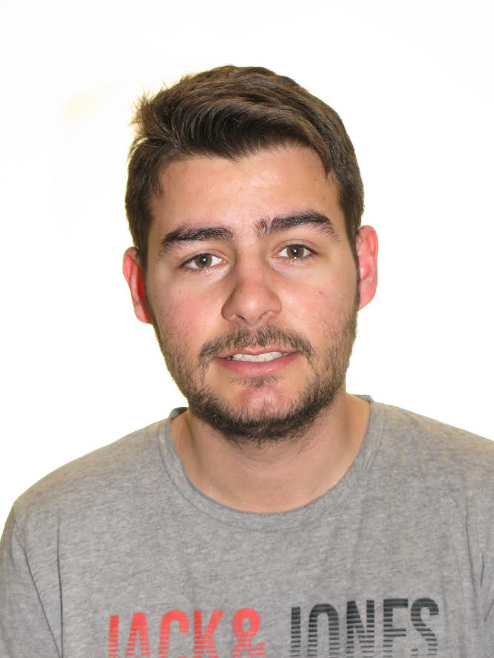
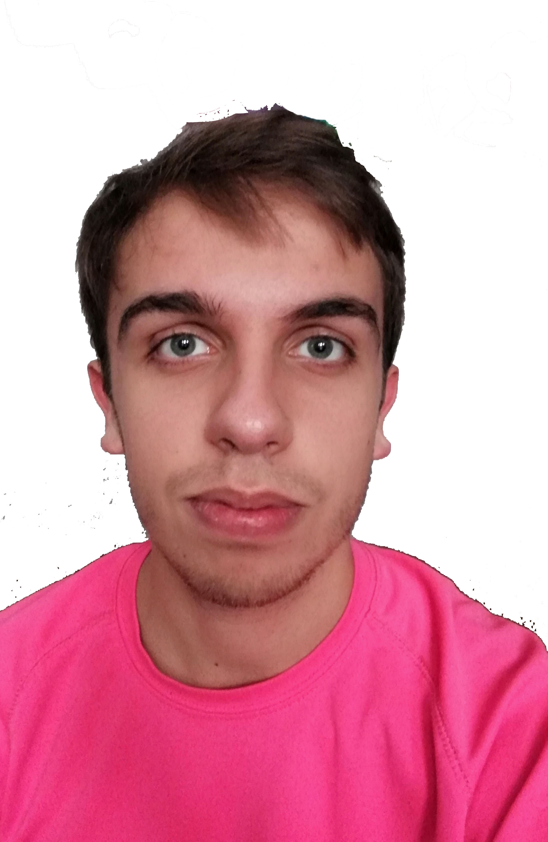
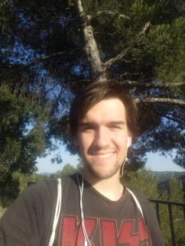
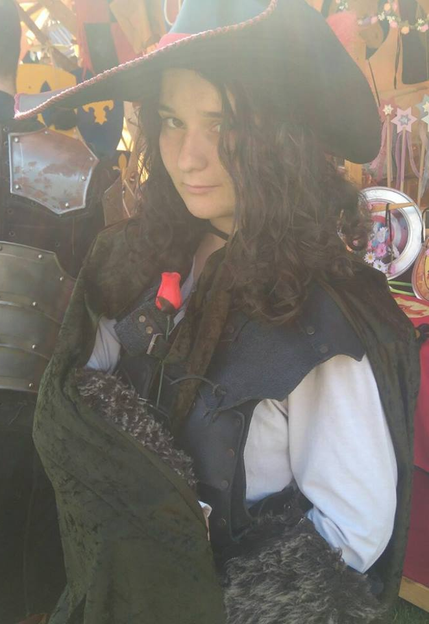
Team members
Josep Antoni costa camps
software engineering
Oriol alás CERCÓS
Computer science
Aarón Acosta fernández
Computer science
Paula Gallucci zurita
Computer science

Slide 3
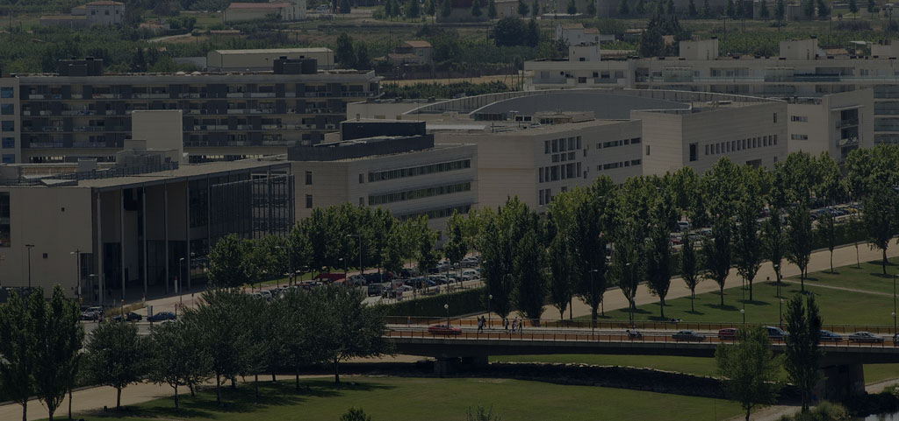
AGENDA
THE STORY
FOCUS
VALUE
DEMO
Q&A

Slide 4
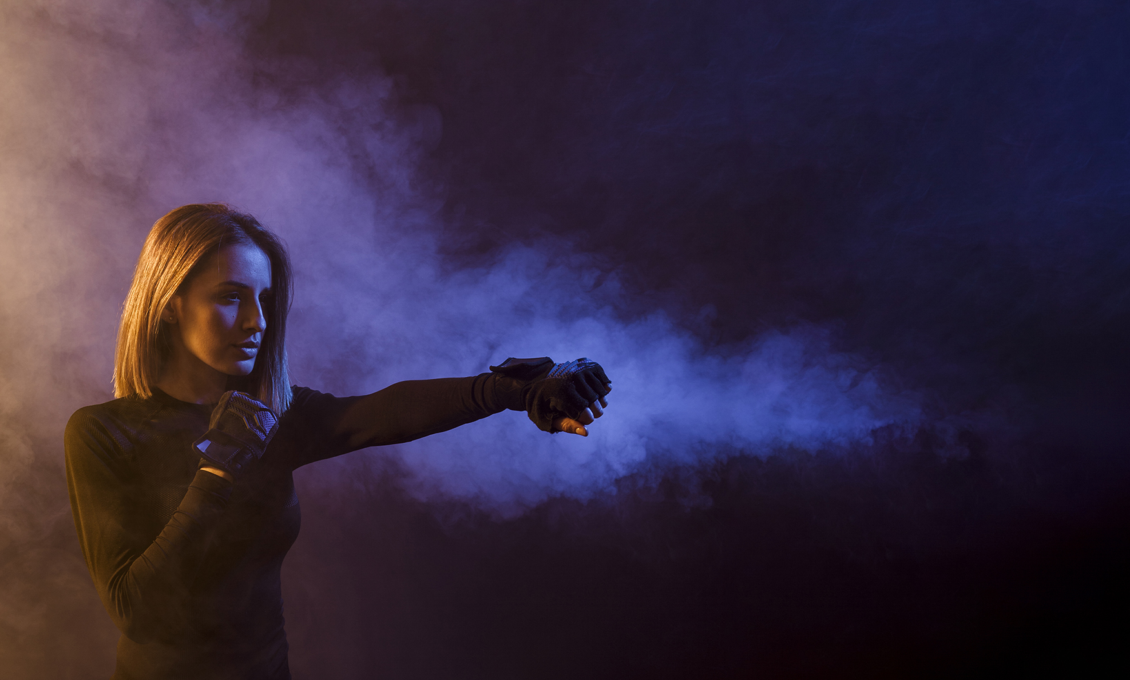
THE STORY

Slide 5




THE DEVELOPMENT

Slide 6
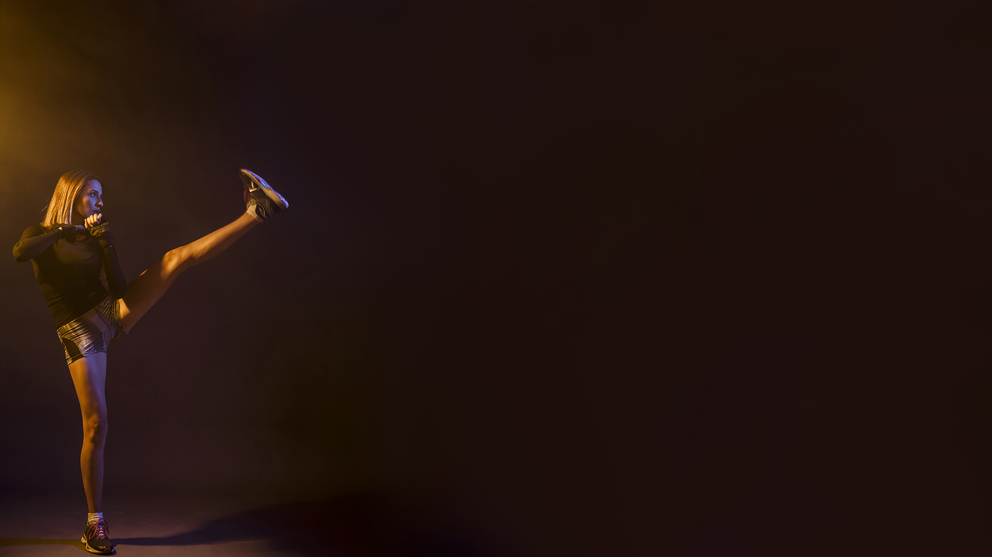
THE VALUE

Slide 7

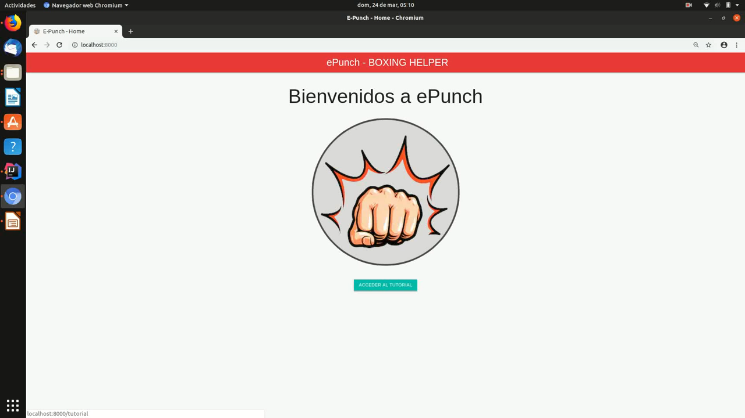
DEMO i

Slide 8
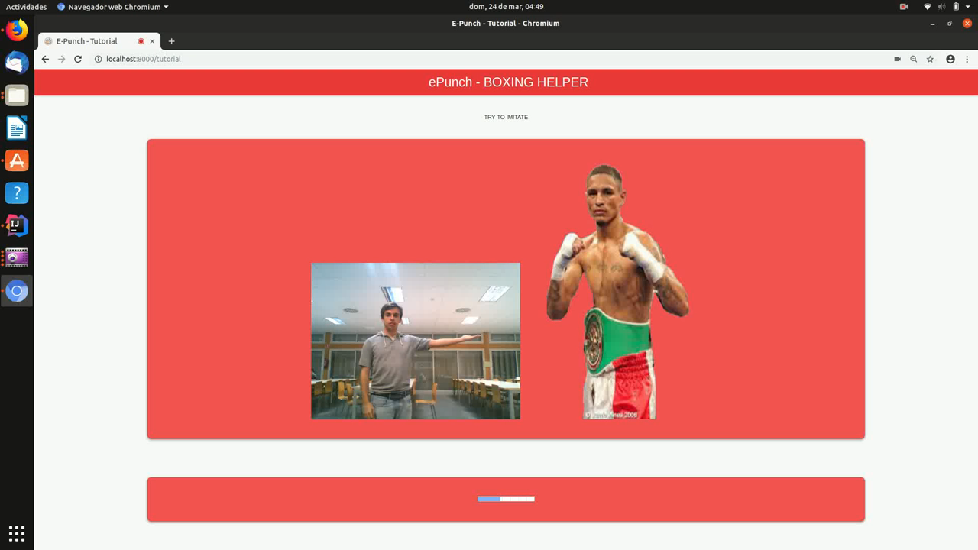
DEMO II

Slide 9

Q
A
&

Slide 10

THANK YOU!

